Slide 1
Computer arithmetic

Slide 2
Addition and Subtraction
Normal binary addition
Monitor sign bit for overflow
Take twos compliment of subtrahend and add to minuend
i.e. a - b = a + (-b)
So we only need addition and complement circuits

Slide 3
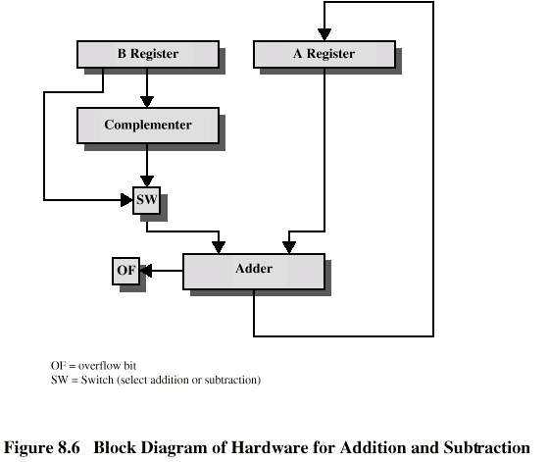
Hardware for Addition and Subtraction

Slide 4
Multiplication
Complex
Work out partial product for each digit
Take care with place value (column)
Add partial products

Slide 5
Multiplication Example
1011 Multiplicand (11 decimal)
x 1101 Multiplier (13 decimal)
1011 Partial products
0000 Note: if multiplier bit is 1 copy
1011 multiplicand (place value)
1011 otherwise zero
10001111 Product (143 decimal)
Note: need double length result

Slide 6
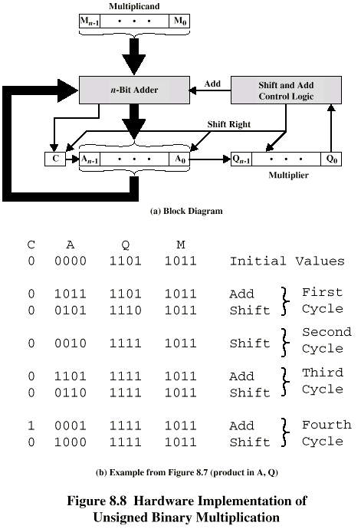
Unsigned Binary Multiplication

Slide 7
Execution of Example

Slide 8
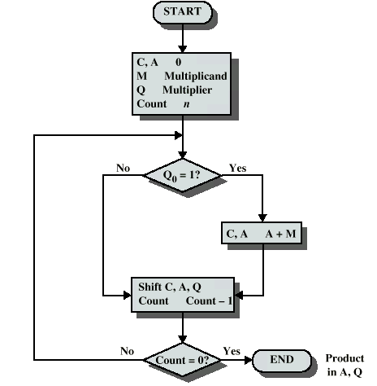
Flowchart for Unsigned Binary Multiplication

Slide 9
Multiplying Negative Numbers
This does not work!
Solution 1
Convert to positive if required
Multiply as above
If signs were different, negate answer
Solution 2
Booth’s algorithm

Slide 10
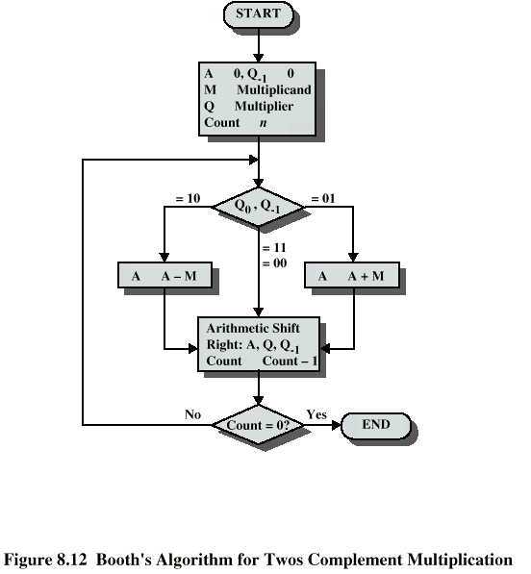
Booth’s Algorithm

Slide 11
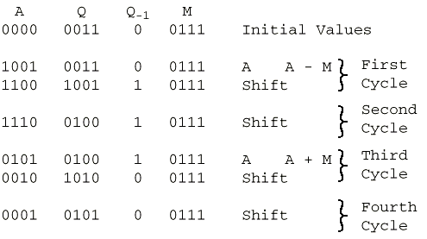
Example of Booth’s Algorithm

Slide 12
Division of Binary Integers
00001101
Quotient
Divisor
1011
10010011
Dividend
1011
001110
Partial
Remainders
1011
001111
1011
Remainder
100

Slide 13
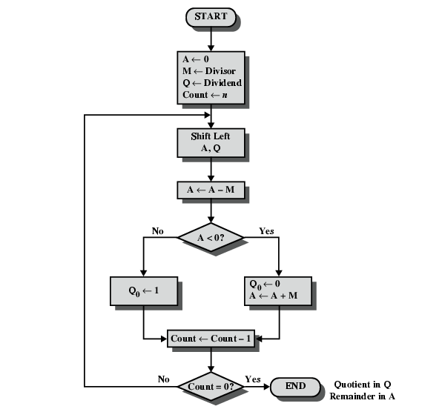
Flowchart for Restoring Division Algorithm

